Slide 1
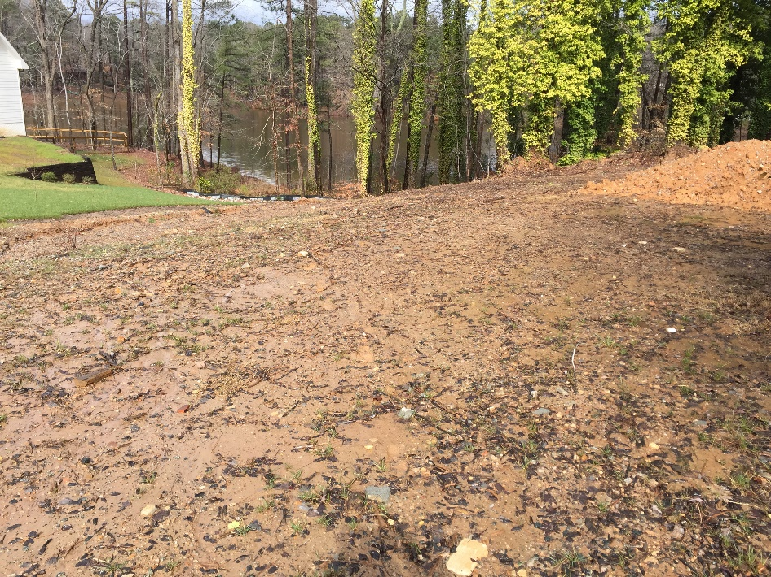
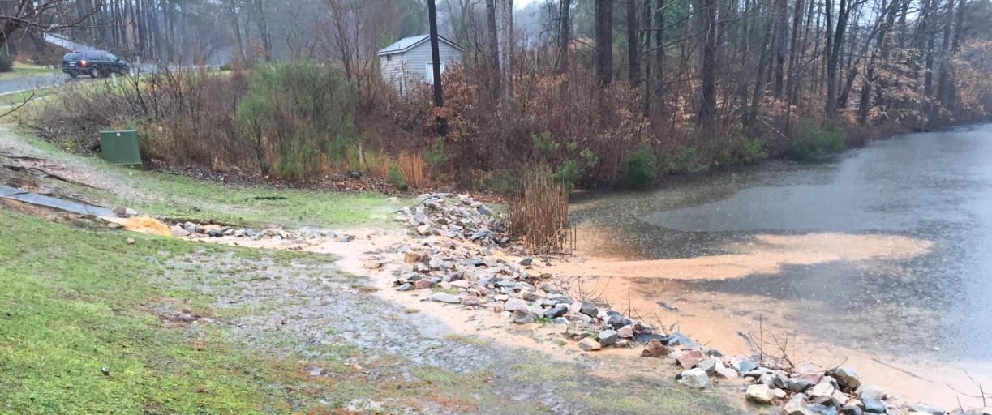
18 Feb 2016 To: Raleigh Stormwater Inspections Section From: Springdale Estates Lake Committee Re: Erosion from the bare soil and bare piles of fill on 8619 ONeal Road into Lower Springdale Estates Lake. Path B Dear Raleigh Stormwater Inspection Service: Here are photographs documenting the second path by which erosion from 8619 ONeal is reaching and entering Lower Springdale Estates Lake. They were taken on 16 Feb 18. It had rained the previous night and during that rain event erosion from the bare soil on 8619 ONeal ran into the Lake by two paths. One path was documented in our communication of 4 Feb (one photo from this communication is shown below). We greatly appreciate that you followed up and examined the site after this erosion and contacted the party responsible for the lot, and that you will be visiting the site to examine the second path through which erosion is reaching the Lake. Sincerely. Van Cotter for The Springdale Estates Lake Committee
8619 ONeal Road
3 Feb 2016
Early in the rain storm showing erosion from 8619 ONeal into Lower Springdale Lake.
16 Feb 2016
Second path by which erosion from 8619 ONeal is flowing into Lower Springdale Estates Lake.

Slide 2
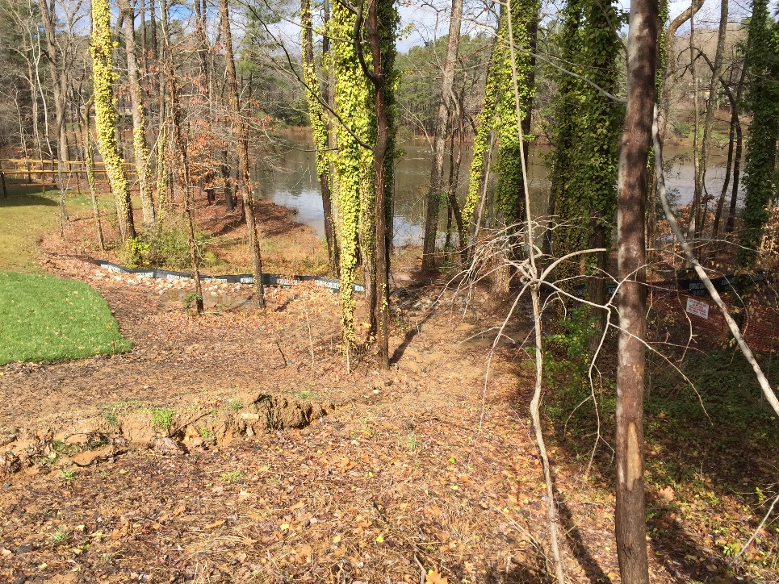
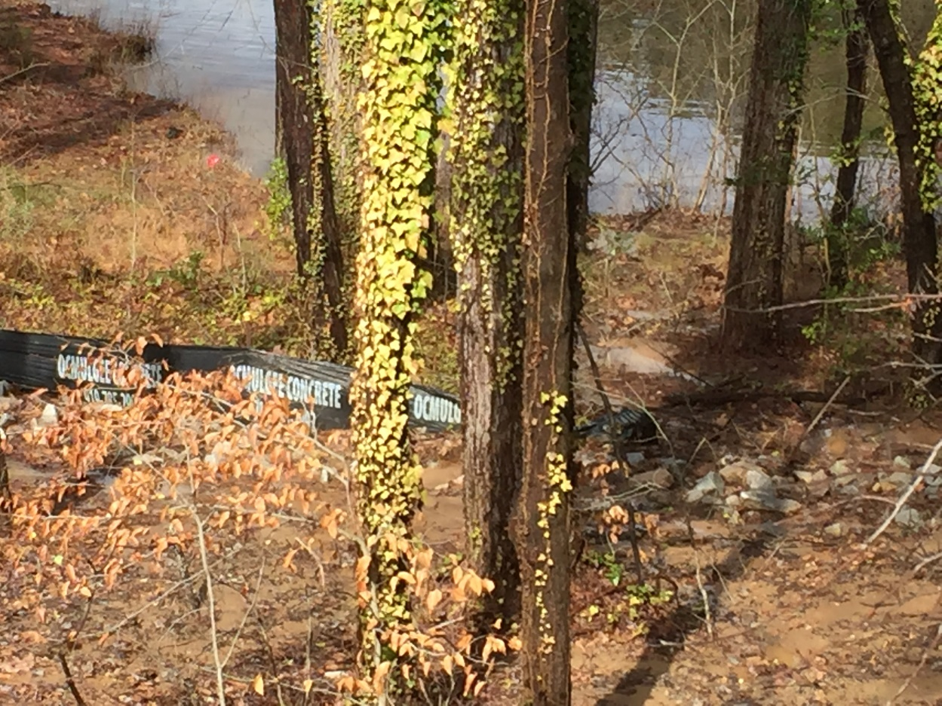
Erosion from the bare soil and bare piles of fill on 8619 ONeal Road into Lower Springdale Estates Lake. 16 Feb 2016.
Second path by which soil eroding off 8619 ONeal flows into Lower Springdale Estates Lake.

